Slide 1
Construction of a PT-Symmetric Mechanical System and Observations of its Phase Transition
By: Jon Mrowczynski

Slide 2
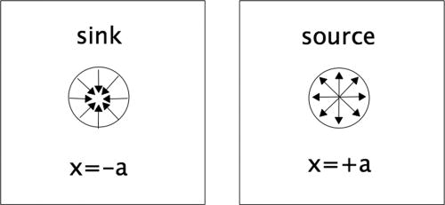
PT What Now?
Figure 1: A simple PT-symmetric system
Isolated, the system never reaches an equilibrium state.
Under sufficient coupling they will come to an equilibrium state.

Slide 3

Quantum Mechanical PT-Symmetric Hamiltonians
The Hamiltonian!
Gives info. on energy states of a system
Unbroken PT-Symmetry
Sufficient coupling
All real eigenvalues
Broken PT-Symmetry
Low coupling
Both real and complex eigenvalues
Where’s the Phase Transition?
At the boundary between these two regions
These states can be observed in a mechanical system!
But how…!?
With two coupled driven pendulums!
Mmm…Haaaaaaam…

Slide 4
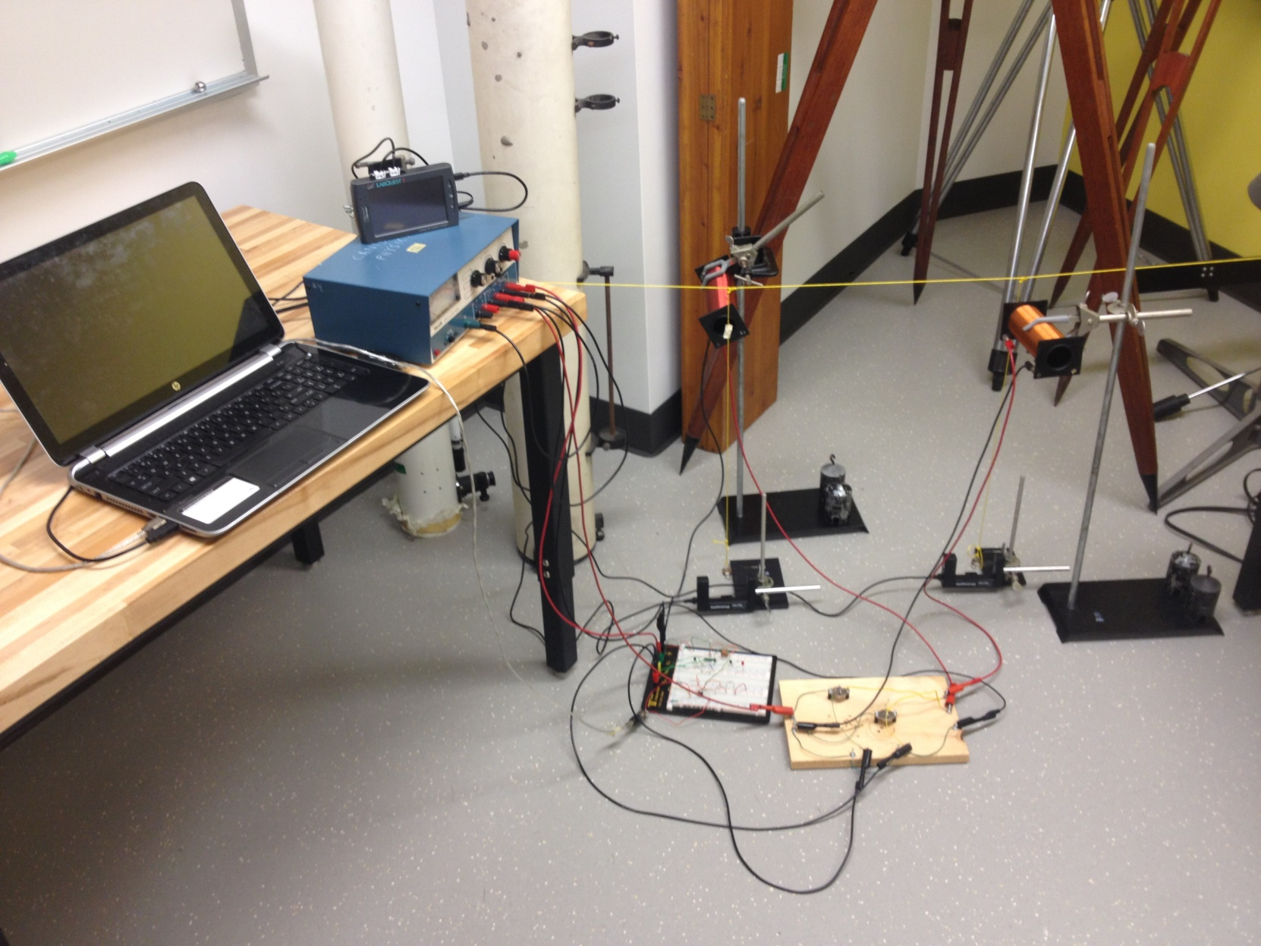
The Apparatus

Slide 5
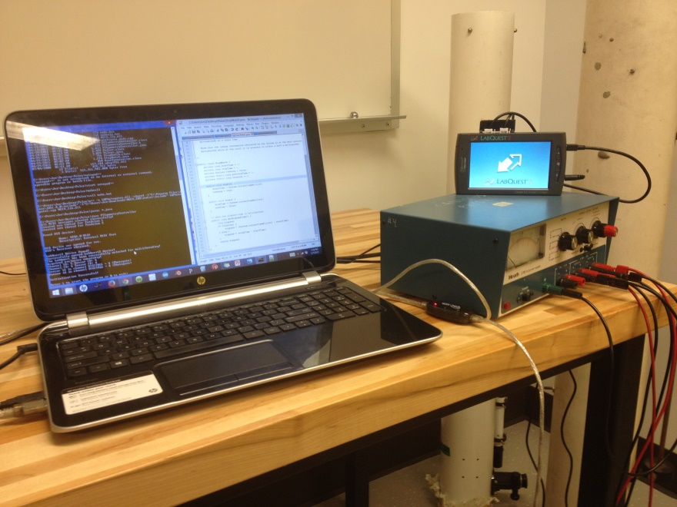
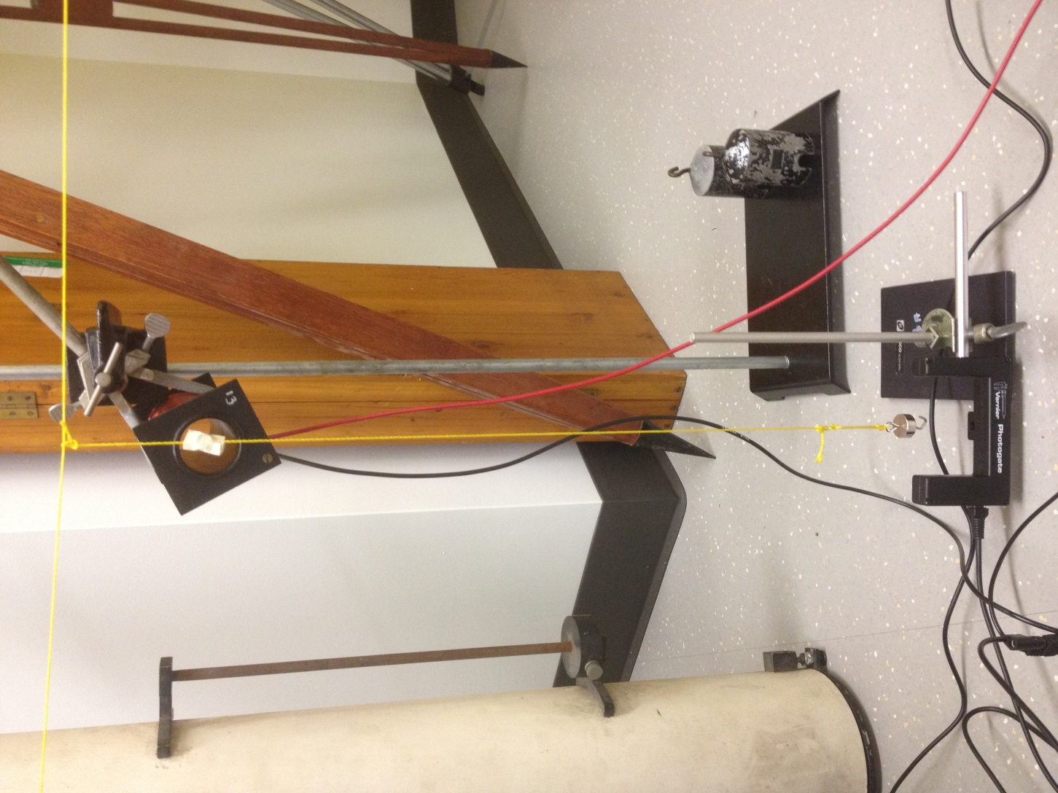
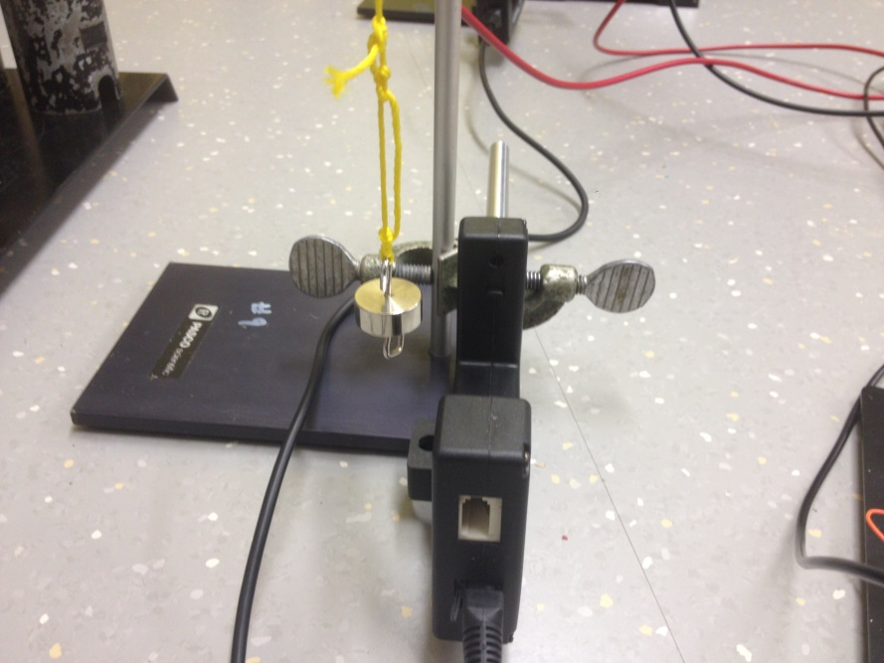
A Closer Look

Slide 6
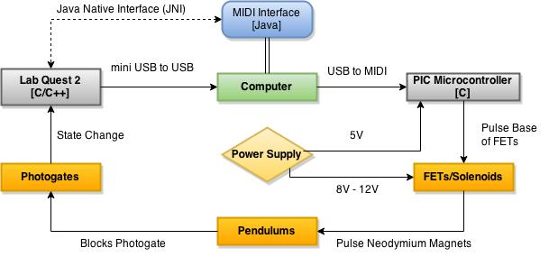
What Did I Just Look At?

Slide 7
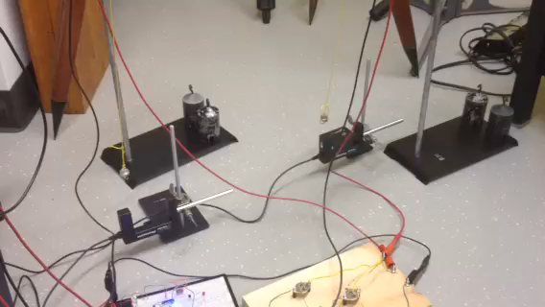
Unbroken PT-Symmetry

Slide 8
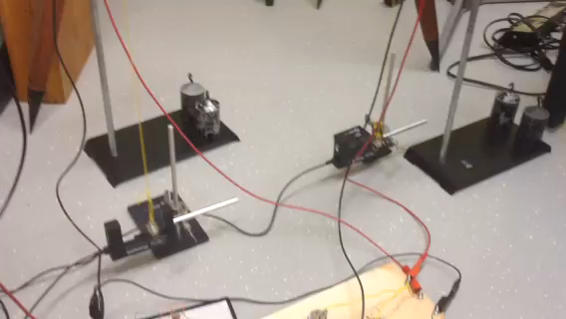
Broken PT-Symmetry

Slide 9

Conclusion
A PT-symmetric mechanical system was constructed!
Base apparatus/control system works
Can be extended for qualitative analysis
Definitely problems with the apparatus
Pendulum detection
Somewhat temporary
Very touchy
We observed the behavior we expected!
Broken PT-symmetry with low coupling
Unbroken PT-symmetry with sufficient coupling

Slide 10
That’s all Folks!
Special Thanks to
Dr. Sheets and Chrissy Colson for helping with the construction of the apparatus.
CJ, Angelo, Amy, Luke, and Jim the robot for always being supportive in all of our physics endeavors!
References:
(1) C. Bender, B. Berntson, D. Parker, E. Samuel “Observation of PT phase transition in a simple mechanical system,” Am. J. Phys. (2013)

